Slide 1
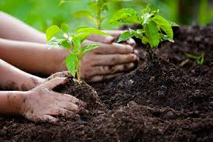
GO-GREEN
BY: Team Rhythm
Alekhya kadiri 001564618
Apeksha Khandelwal 001091651
Shalini Siddabathula 001008895

Slide 2
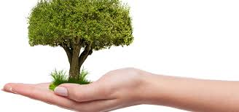
PROBLEM STATEMENT
The loss of trees and other vegetation can cause climate change, desertification, soil erosion, fewer crops, flooding, increased greenhouse gases in the atmosphere, and a host of problems for indigenous people.
To overcome this issue we have come up with an idea called GO-GREEN by which we can protect our mother earth and thereby save our habitat.

Slide 3
APPROACH
Consider a primary caretaker who will manage and monitor the plantation.
As a self volunteer we can raise a tip and update the authority can help in growing plants.
As a user you can self volunteer yourself on any particular day and time.
As a care Taker for plantation they can request for all the plantation requirements.
As a member of an NGO we can raise a pool request and update the authority and help in growing more plants.

Slide 4
KEY FUNCTIONALITIES GO-GREEN
Capture details of every employee and user involved
Enter our zip code to know our geographical location.
Capture the cause of our plantation
Notify the concerned authority about our requirement
Provide necessary supplies ex: pesticides, fertilizers etc.
Forward the request to the concerned headquarter authorities and take necessary actions

Slide 5
KEY FUNCTIONALITIES GO-GREEN
Schedule meetings with respect to request received
Ensure to solve problem based on the request
Suppliers are assigned by a manger for every valid request
Request for funds from investors
Deny request if invalid
Maintain a list of all the requests received.

Slide 6



ACTORS:
Headquarters
NGO
Government
Investor
Corporate
Care Taker
User
Admin

Slide 7
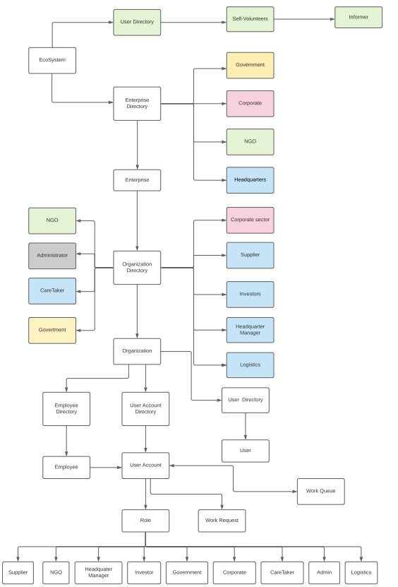
ECOSYSTEM

Slide 8
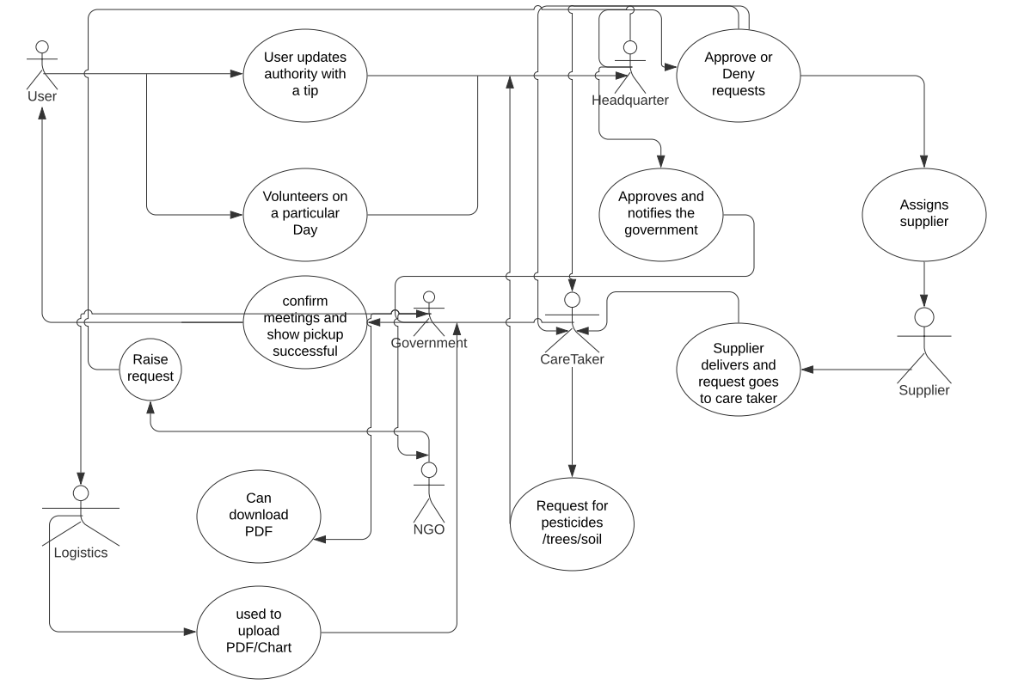
USE CASE DIAGRAM

Slide 9
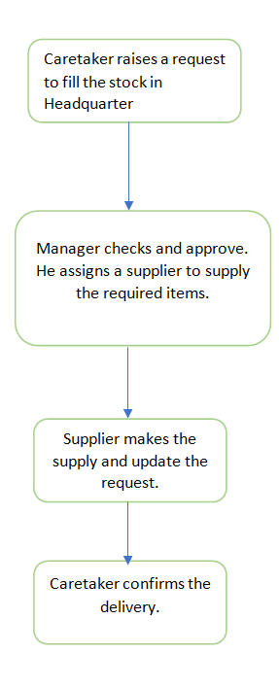
Work Request-1

Slide 10
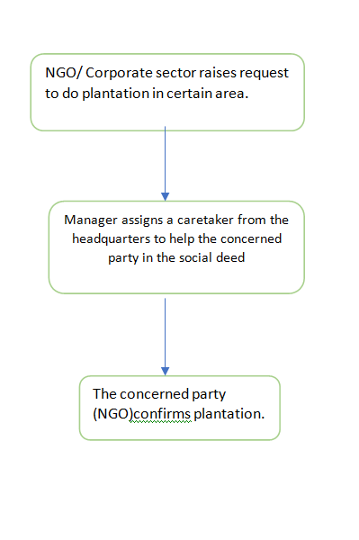
Work Request-2

Slide 11
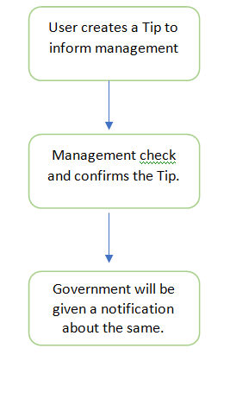
Work Request-3

Slide 12
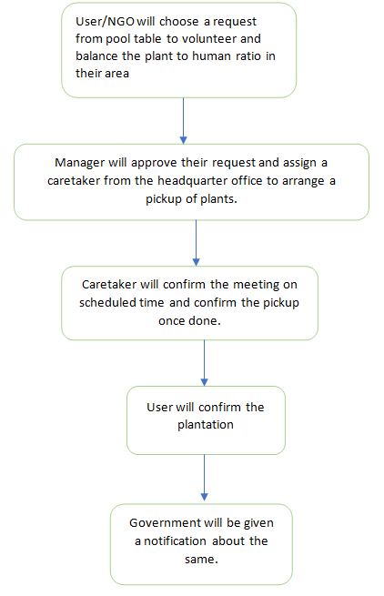
Work Request-4

Slide 13
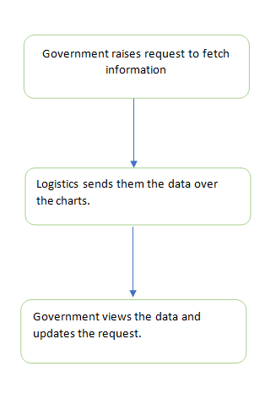
Work-Request-5

Slide 14

THANK YOU

